Slide 1
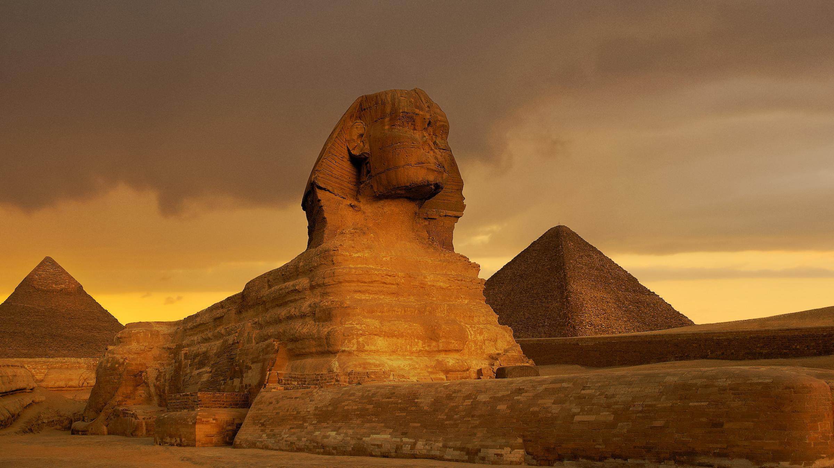
THE ANCIENT EGYPTIANS
By Meabh

Slide 2
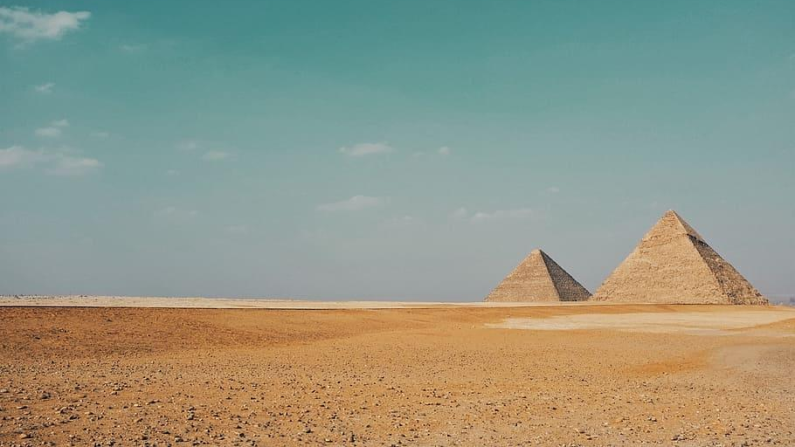
PAGE
Page 1- Who were the Egyptians?
Page 2- Where is Egypt?
Page 3- Pharaohs
Page 4-Pyramids
Page 5-Hieroglyphics
Page 6-Gods and Goddesses
Contents

Slide 3
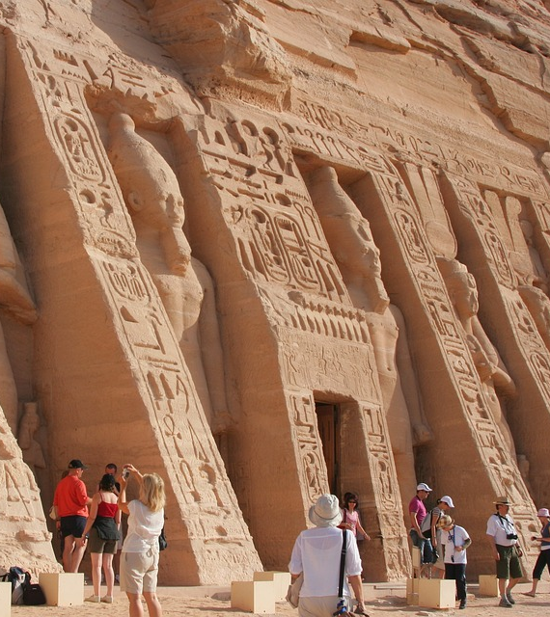
WHO WERE THE EGYPYIANS?
The Egyptians were people who live in Egypt and are mostly known for their crazy beliefs and sandy deserts.
This Photo by Unknown author is licensed under CC BY-SA.

Slide 4
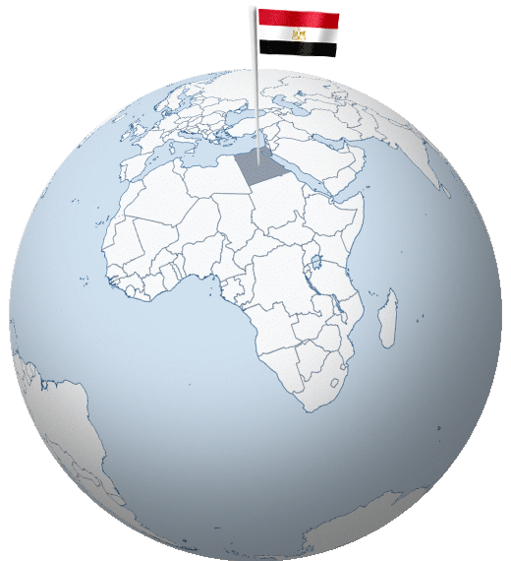
WHERE IS EGYPT?
Egypt
Egypt is located around the North of Africa. It's population is over 100 million

Slide 5
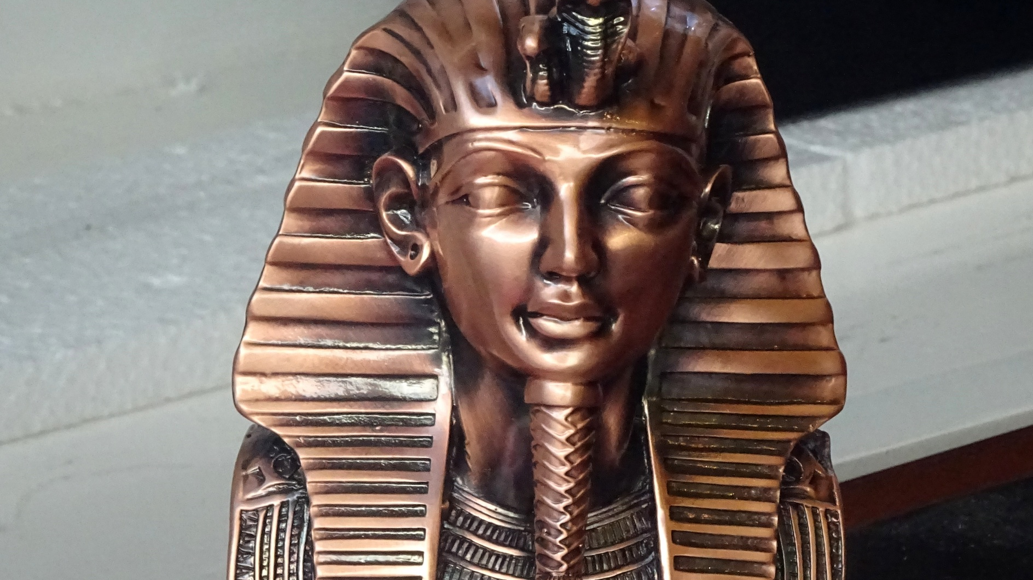
PHAROAHS
Pharoahs are very important Egyptian people. When Pharaohs die they are mummified .and a pyramid is mostly used as a gravestone for the mummified Pharaohs.

Slide 6
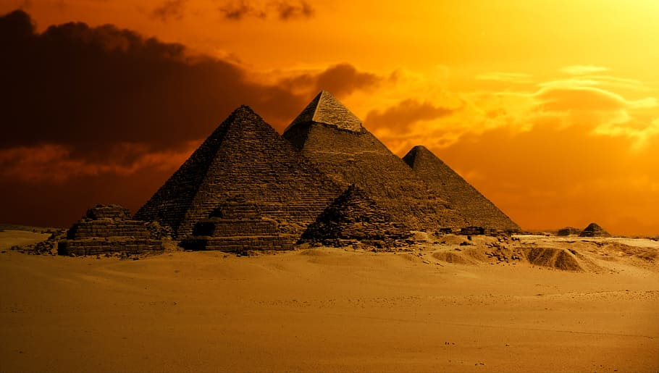
PYRAMIDS
Pyramids are gravestones for the very important dead people. It would take many people and many years to make one pyramid.

Slide 7
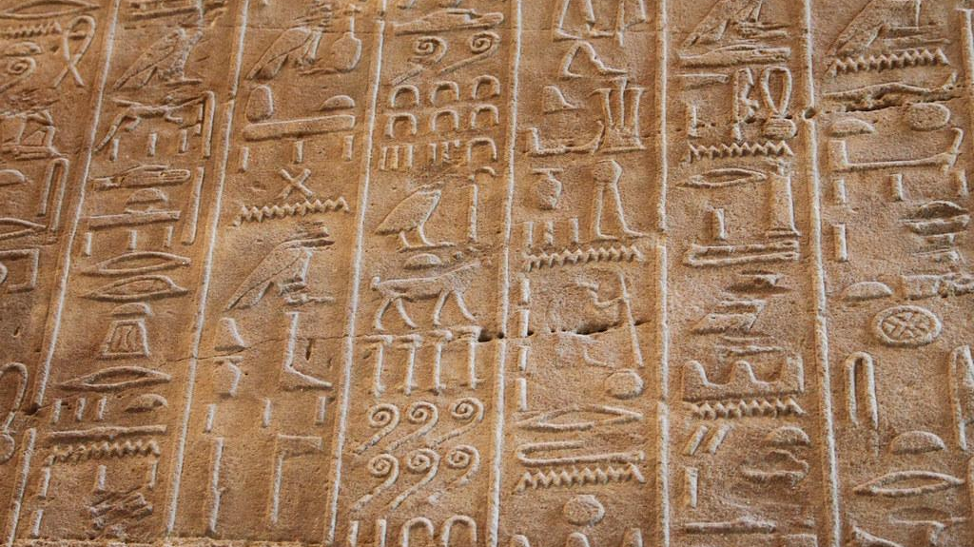
HIEROGLYPHICS
Hieroglyphics are the Egyptian form of writing, they can be found in pyramids telling the Pharoahs life story.

Slide 8
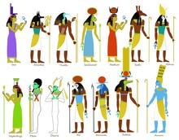
GODS AND GODDESSES
Egyptians have many beliefs and that includes gods and goddesses the most known gods and gooddesses include Isis, Osiris,Thoth, Sekhmet and are spritial people.

