Slide 1
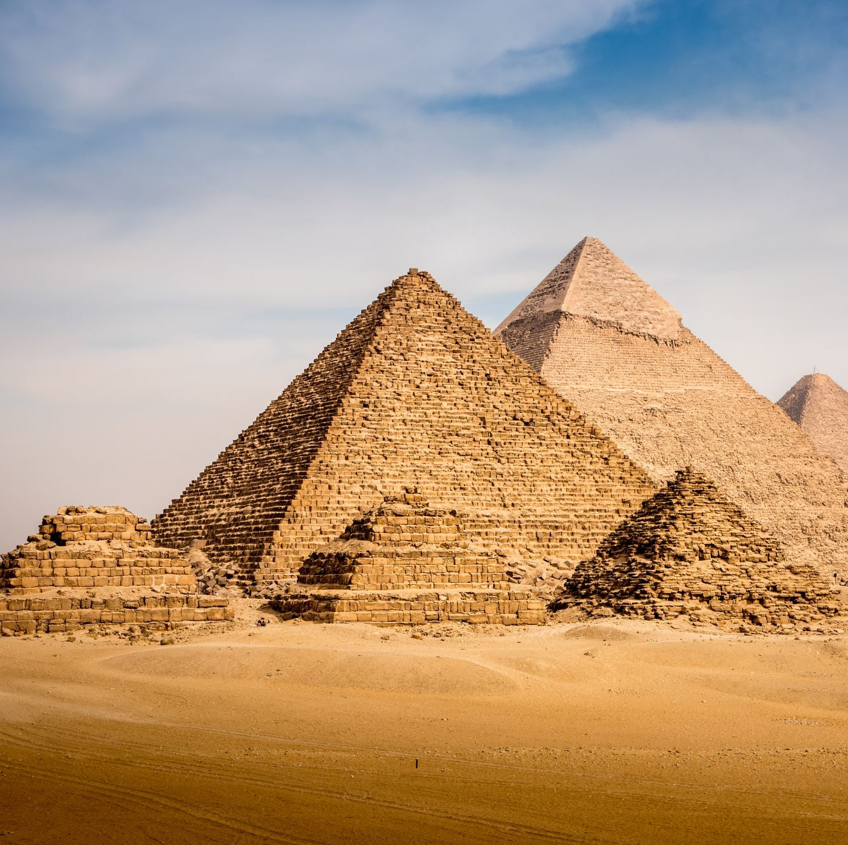
Ancient Egyptians
By Ersin Tatli

Slide 2
Contents
Slide 1 –Where is Egypt?
Slide 2 –Who were the Egyptians?
Slide 3 -Hieroglyphics
Slide 4 –Gods and goddesses
Slide 5 -Pyramids

Slide 3
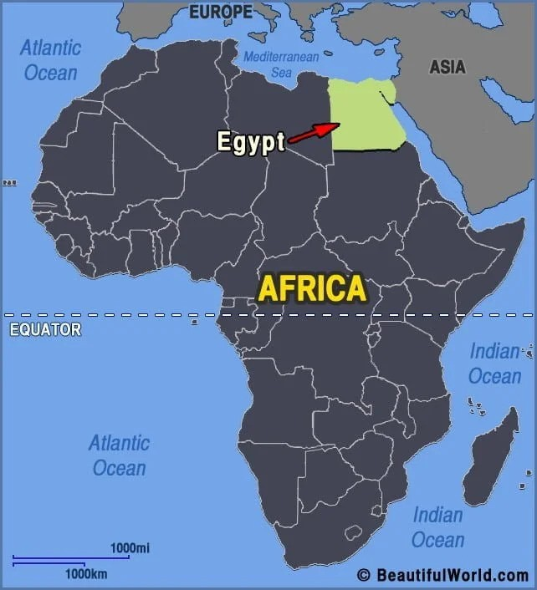
Where is Egypt?
Egypt is in the continent of Africa.
Egypt is in between Libya and Saudi Arabia.
Egypt is right beside Israel.
The capital of Egypt is Cario.

Slide 4
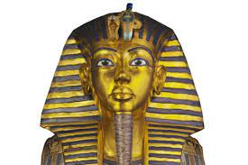
Who were the Egyptians?
Most Ancient Egyptians were probably descended settlers who moved to the Nile valley in prehistoric times.
90 percent of the population is Muslim just like me.

Slide 5
Hieroglyphics
Hieroglyphics was the Ancient Egyptians writing system.
It was carved into the walls
It is a series of pictures and symbols

Slide 6
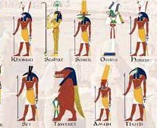
Gods and Goddesses
Gods and goddesses were worshipped and looked up to by the ancient Egyptians
One of the most important gods was Ra. He was the god of the sun
Many of the gods and goddesses were drawn in human and animal form.

Slide 7
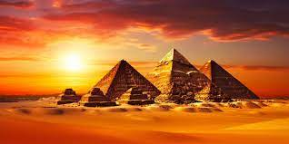
Pyramids
The biggest pyramid in Egypt is the Pyramid of Giza.
The pyramid of Giza is 146 meters tall.

Slide 8
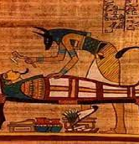
Mummification
Mumification is a proses where you preserve a body by taking out the organs and wrap them in linen.
They do this because their body comes with them in the after life.

