Slide 1
Welcome to P6/7
Miss Cunningham

Slide 2
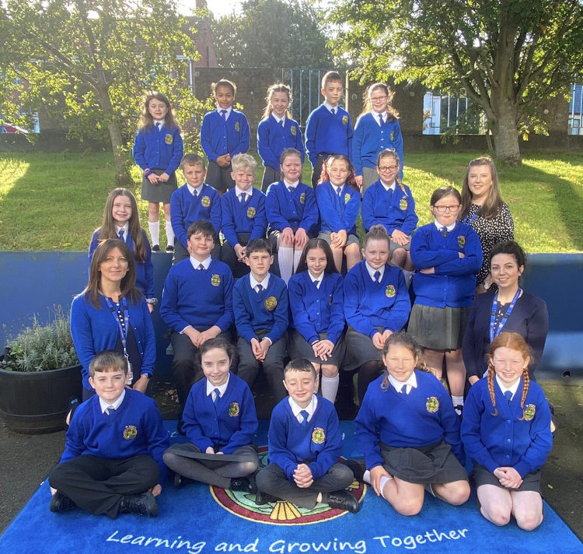

Slide 3
House keeping
Dinners £2.60 per day (£13.00 per week)
School starts at 8.55 AM & School finishes at 2.55PM (Friday 1.55pm)
Children with younger siblings will leave at the earlier time with their sibling.
Please ensure all children bring a healthy break to school.
If you would be interested in S’Cool Club or breakfast club please register your interest with Mrs Moore in the office.
S’cool club Mon – Fri 2pm – 5pm (Price TBC)
Breakfast club 80p per day.
If children are to walk home/to the carpark please give permission via the office.

Slide 4
‘R’ golden Rules
In school we have ‘R’ Golden Rules. These are positive things that we will endeavour to do.
We respect ourselves and our work.
We respect others
We respect our school
We are responsible for own actions
We are responsible for our safety

Slide 5
Safeguarding
We ensure that all our children feel safe and secure at school. Please see our child protection brochure for parents which outlines the various procedures in place at St Brigid’s. If you have a concern, please do not hesitate to contact us.
The Safeguarding team:
Designated Teacher for Child Protection (DT) – Ms Lloyd.
Deputy Designated Teacher (DDT) is Mrs Devlin.
Principal (DDT) – Mrs Miller
ICT Co-ordinator – Mrs McCavera
Governor responsible for CP – Mrs P Martin
Chairperson of Board of Governors – Mr B Smyth.

Slide 6
Curriculum
Numeracy (Mental Maths, Number, Shape & Space, Data Handling, Investigations/Problem-Solving)
Literacy (Phonics, Reading, Writing, Talking and Listening)
WAU: Flight, Our World, Faith & Light, Young Enterprise, Aspiring for Excellence.
Grow in Love
PDMU Paths programme
PE: Athletics, dance, games and gymnastics
The Arts
ICT
Nurture

Slide 7
Numeracy
This year in numeracy we will cover the follow aspects
Number
Place value of numbers | Money in decimal notation
Estimation | Percentages
Sequences | Algebra
Decimal notation to three places | Calculator calculations
Negative numbers | Fractions
Number patterns | Squared & triangular numbers
Measures
Weight | Time
Volume & Capacity | Length
Area
Shape & Space
Angles and rotation | Symmetry
2D and 3D shapes | Co-ordinates
Compass points | Programming
Data Handling
Graphs | Probability
Mean & Averages | Range
Using computer database | Interpreting data
Mental Maths
Counting on & counting back | Rounding and adjusting
Partitiong | Using factors
Using equivalences | Inverse operations
Re-ordering

Slide 8
Literacy
The literacy Curriculum is made up of areas;
Talking and Listening
Phonics & Spellings
Grammar & Punctuation
Handwriting
Writing
Reading
In Term 1A our writing focus is Recount Writing
Our first class novel is Wonder.

Slide 9
WAU
This year our WAU topics will be:
Flight
Our World
Faith & Light
Young Enterprise
Aspiring for Excellence
Through connected learning, children will gain skills in all curricular areas as well as developing Thinking Skills and Personal Capabilties.

Slide 10
Grow in love
Through the Grow in Love programme, children will have opportunities to explore their spiritual, moral and religious lives, as well as learning about the life of Jesus.
The Primary 7 children will also prepare for the Sacrament of Confirmation. The date of which is TBC.

Slide 11
ICT
All children will receive their school login and password so that they can access MySchool from home.
This term we will be focusing on Computation Thinking and Coding. This is made up of many aspects
Unplugged coding
Coding games & apps
Coding devices
Block Based Coding
Through all curricular areas children will also learn to explore, express, exchange, evaluate and exhibit.

Slide 12
Pe
Our class PE day is Thursday.
On this day, children may come to school in their PE uniform.
This includes;
White school PE t-shirt
School jumper or cardigan
Plain navy jogging bottoms/leggings (no logos)
Trainers
Swimming – May resume later in the year. We will keep you updated.

Slide 13
Homework
All children have a homework folder, please ensure that this is brought to school everyday.
Homework for the week will be split into two parts.
Monday (returned on Wednesday) : Paper Homework
Mental Maths and English Skills for Mon & Tues
1 Literacy & 1 Numeracy homework
THIS WILL BE SENT HOME ON A MONDAY AND RETURNED TO SCHOOL ON WEDNESDAY.
Wednesday & Thursday: Online homework
1 Literacy & 1 Numeracy homework completed on Seesaw.
Mental Maths and English Skills for Wed & Thur (completed on paper and returned on Friday )
Reading – Daily
Phonics – Practice spellings days
Mental Maths – Practice mental maths focus for that week.
Please sign all homework and reading record books.

Slide 14
Seesaw
Seesaw will be used to complete online homework tasks.
You will need to download both the Seesaw family app and Seesaw class app to a device.
Seesaw Class – This will be used by the child. We would advise that this is downloaded onto an ipad/tablet which your child has assess to. This will be where they will complete their homework. Please set this up in their name.
Seesaw Family – This will be used by the parents for communication between parent and teacher.
If you need another QR code please let me know.

Slide 15
Covid – 19
Children are in their class bubble.
At drop off and pick up please be mindful of social distancing requirements and consider wearing a mask.
Our classroom is regularly sanitised and children regularly wash their hands.
In light of current guidelines, if you, your child or anyone in your household is experiencing any symptoms of Covid-19, please alert the school immediately and self isolate, before organising a test.
Symptoms include;
a high temperature
A new, continuous cough
A loss or change to your sense of smell or taste.
More information is available at https://www.nhs.uk/conditions/coronavirus-covid-19/

