Slide 1

Welcome to Primary 4
A Guide for Parents

Slide 2
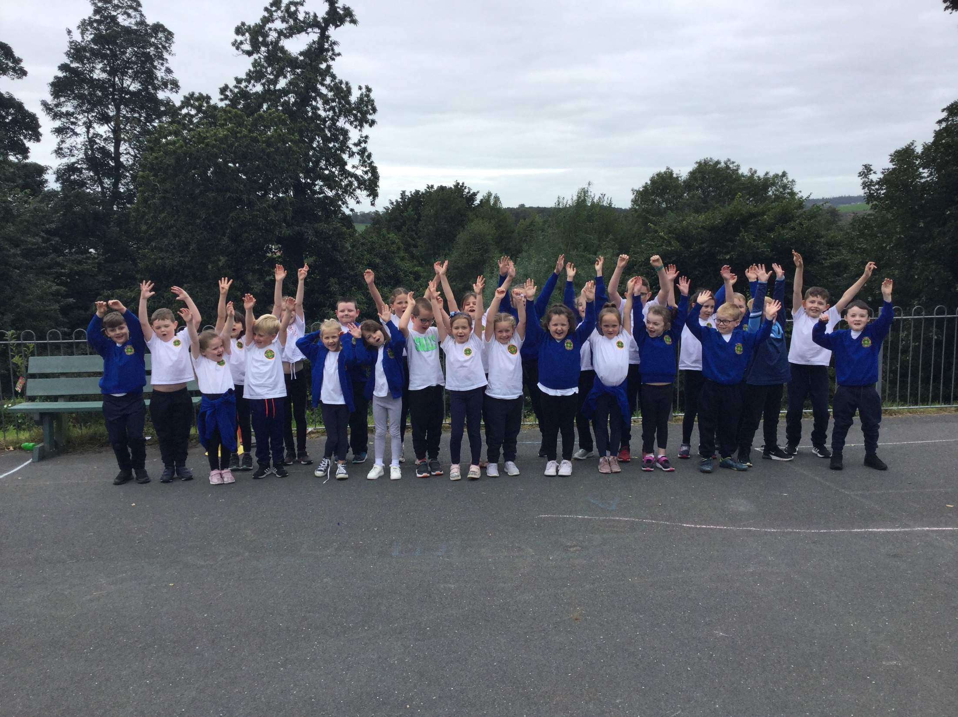
Look who’s jumping into Primary 4

Slide 3
Outline of Presentation
General Routines
Literacy
Phonics
Numeracy
World Around us
PE
Homework
Class Behaviour Code
How can I help my child?
Other information
Child protection
Aims for your child

Slide 4
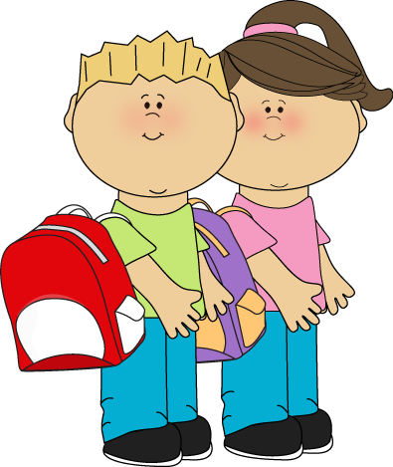
General Routines
Our school day starts at 8.45 to 2.45pm (Friday 1.40pm)
If you have given written permission, children may walk to car park/home
Monies will all soon be paid electronically – but in the meantime, dinner money may be sent in an envelope, clearly marked which days your child is taking dinners.
Dinners remain at £2.60 per day
Please contact the office or advise me via seesaw if your child is sick

Slide 5

Literacy
These are the comprehension skills we will teach-summarising, inferring, making connections, monitoring, evaluating, synthesising and predicting.
We will continue with cursive handwriting
Our grammar work will focus on:
Alphabetical order-using a dictionary
Nouns (collective- e.g.. a herd of sheep)
Common and proper nouns
Adjectives (describing words)and alliteration e.g. squawking seagulls.
Verbs (past and present tenses and adverbs )
Pronouns – I, he , she.
Contractions – making longer sentences
Proof reading skills

Slide 6

Phonics
Phonics will be incorporated into Primary 4 Literacy programme.
Tricky words and sounds should be revised every night with your child.
Help your child with their learning in preparation for their Friday assessment (dictation, quiz, puzzle)
Focus on sound rather than letter name
Spellings will be posted through Seesaw.

Slide 7

Numeracy
This term we will cover in number:
Place Value
Addition and subtraction up to 4 digits
Times tables- 2,3,4,5,10
Rounding numbers to nearest 10/100/1000
Practical Maths
Shape and space- 3D shapes
Measures- length
Handling data- graphs
Maths strategies
At home you can help your child by developing a quick recall of number bonds and multiplication and division facts.

Slide 8
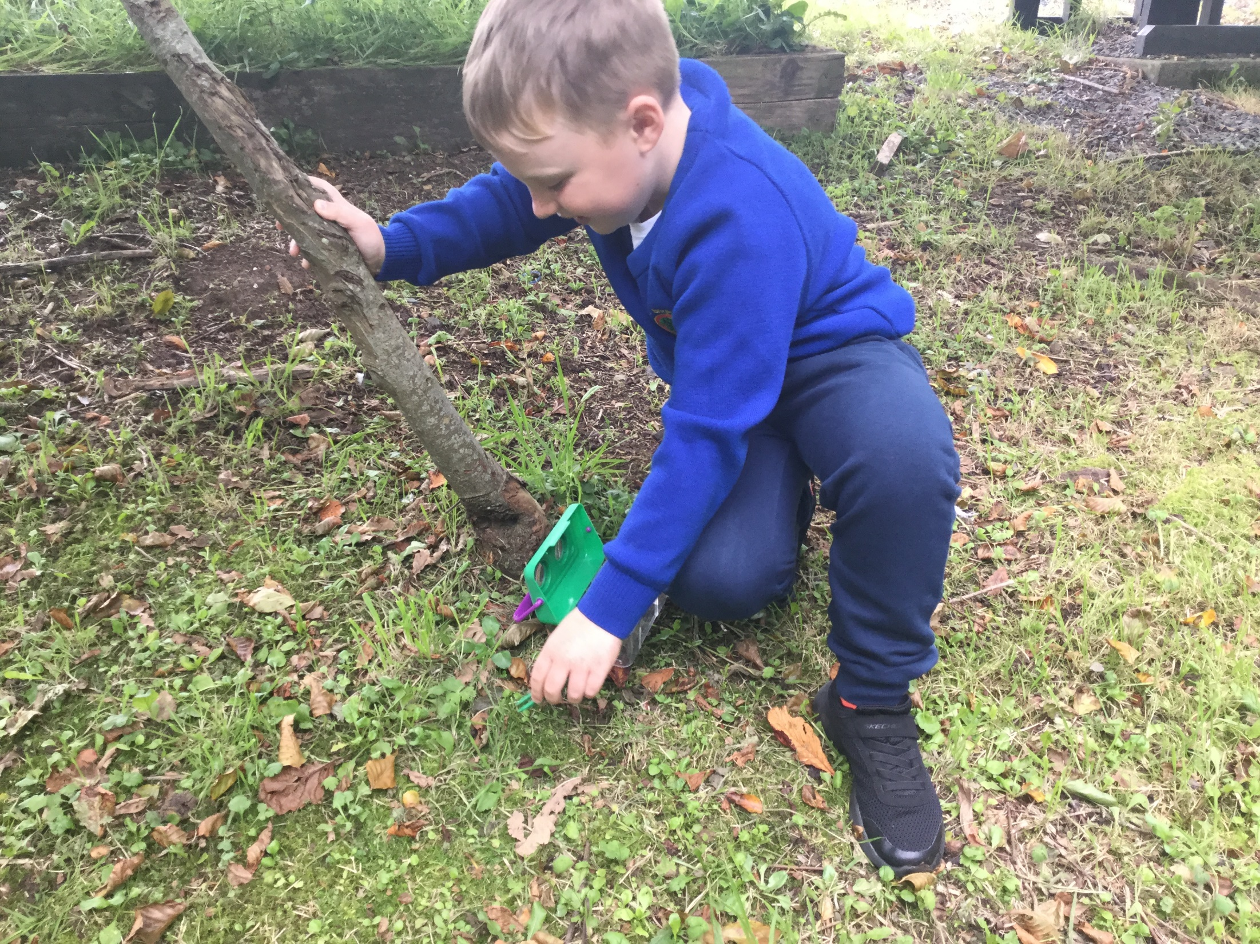
World Around us
World Around Us
Mini Beasts
World War 2
Extreme Weather
Vikings
Local Study
Your child will receive seesaw activities based on these topics.

Slide 9
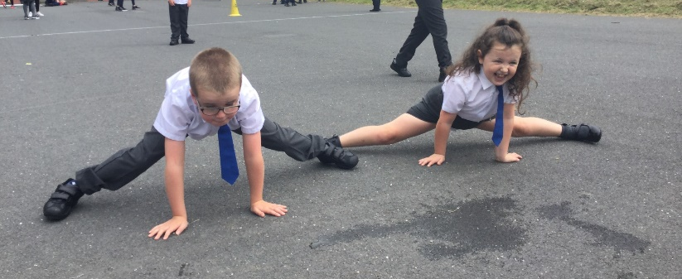
PE
Dance
Games
Athletics
Gymnastics
Ensure your child has navy jogging bottom, white top and appropriate footwear. All items should be worn in on PE day.
PE is every Thursday
Children will also participate in the daily mile, ensuring they get regular daily exercise and work breaks.

Slide 10

Homework
Reading books will be read partly in class and finished at home with guardians and parents.
Pupils will be provided with an extra reading book and should revise their tricky words and times tables every night.
Homework includes:
Mon/Tues – Literacy/ Numeracy through Seesaw
Wed/Thur – Literacy/Numeracy paper copy
All homework should be signed and folders to be brought back each day.

Slide 11
Class Behaviour Code
Work quietly.
Listen to the teacher.
Always do your best work.
Keep my desk area tidy.
Keep my cloakroom area tidy.
We will walk safely in school.
Wash our hands.
Stay within our bubble.
Always put your hand up to ask a question.

Slide 12
How can I help my child?
Read with your child every night; either to them or hear them read.
Go over spellings/tricky words and tables.
Insist on your child’s best work when completing homework.
If you wish to contact me, you can contact through seesaw or through email sbraniff697@c2kni.net.

Slide 13
Other Information
Class Nurture Sessions have started were your child is encouraged to express their feelings and engage in circle time. They enjoy fun activities within a comfortable environment
First Confession- 22th October 2.00pm
Holy Communion- 15th May 10am
It is important that you child has good attendance and is arriving to school on time. Healthy Break Time
If your child is feeling unwell please be mindful of the symptoms of Covid 19.

Slide 14
Child Protection
We ensure that all our children will feel safe and secure at school. Please see our child protection brochure for parents which outlines the various procedures in place at St Brigid’s. If you have a concern, please do not hesitate in contacting the school.
The Safeguarding Team is as follows :
Designated Teacher for Child Protection ( DT) is Mrs A. Lloyd
Deputy Designated Teacher (DDT) is Mrs L. Devlin
Principal (DDT), Mrs D. Miller
ICT Co-Ordinator is Mrs C. McCavera
Governor responsible for CP is Mrs P. Martin
Chairman of our Board of Governors, Mr B. Smyth.

Slide 15
Aims for your child
To be happy and safe.
To work to their highest potential.
To be proud of their work.
To be responsible for their own actions.
To become an independent worker.
To enjoy P4.

Slide 16


