Slide 1
Welcome to Primary Five
A Guide for Parents

Slide 2
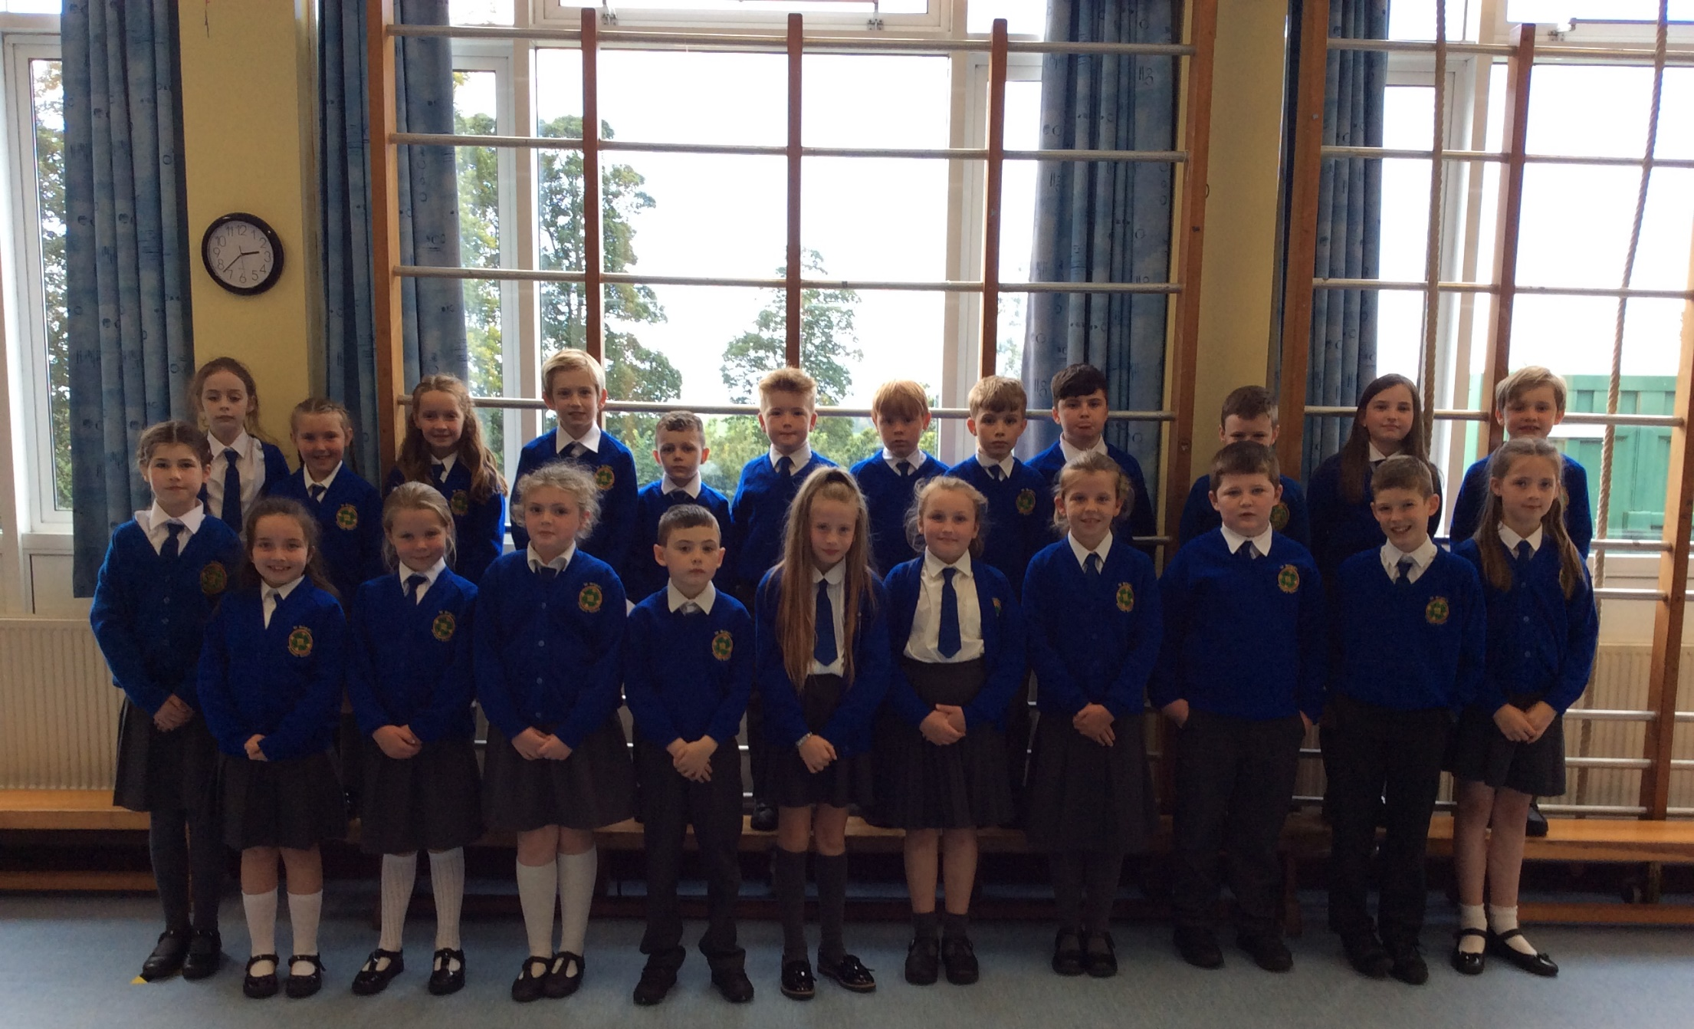

Slide 3
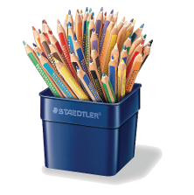
Welcome to Primary 5!
It is fantastic to see all our children back in school. I hope your child will have a fulfilling and happy year of learning. Unfortunately this year we can’t have our normal meeting with all our families together due to our Covid-19 transmission prevention protocols. Your child’s safety and well-being is always our highest priority.
This presentation is to give you information about what our year ahead in Primary 5 will entail.
If you have any concerns about your child please feel free to make an appointment to see me either in person, or if you prefer a Zoom meeting is easily arranged.

Slide 4
In this presentation we will look at the following areas in our school life:
Housekeeping
Numeracy
Literacy
Reading
World Around Us
ICT
Religion
PE
Homework
Covid-19 Measures
Child Protection

Slide 5
Housekeeping:
School dinners cost £2.60
A varied menu has been provided for the children with an emphasis on healthy eating. Dinner money should be forwarded in a marked envelope with the children or by parent-mail direct to the office.
Healthy Break: At St Brigid’s the children are encouraged to eat a healthy break every day which ideally consists of fruit with water.
Children will enter school unaccompanied, and should only enter the school grounds via
the main school gate and should walk down past the hall and then
enter the school by the side door, as they have been doing this year.
From the week beginning Monday 14th September school for
Primary 5 will begin at 9.00 am and end at 3.00 pm.
Children will be brought to the front of the school for collection.

Slide 6
Numeracy:
In Numeracy this year we will be looking at the following key areas:
Number
Shape and Space
Measures
Data Handling
Mental Maths
In mental maths we will be practicing using the following key skills:
- Partitioning
- Rounding and Adjusting
- Counting on and back
- Using Inverse Operations
- Using factors
- Equivalence
- Re-Ordering
At home you can help your child by :
-developing a quick recall of number bonds and multiplication and division facts.
- practising word problems to develop confidence in this area .

Slide 7
Literacy:
Comprehension skills
Each month we will focus on one particular comprehension skill.
These are the skills we will be working on:
Summarising
Questioning
Predicting
Visualising
Clarifying
Making Connections
Synthesising
Inferring
Monitoring
Cursive Handwriting:
We use the cursive style of handwriting at St Brigid’s and we will be practising cursive script with the children regularly and encouraging them to use it in all written work.

Slide 8
Writing.
We will be working on these writing forms throughout the year:
Recount
Report
Instructional
Procedural
Narrative
Explanation
Persuasive
Discursive
Poetry
Letter Writing
In Term 1 we will focus on Recount and Report writing. In Term 2 we will work on be exploring Narrative and Persuasive writing. In Term 3 the specific focus will be Explanation writing.
Phonics
Our phonics programme is designed to encourage children to explore the various ways that sounds can be represented i.e. knew, shoe, through.
We will begin with revision of letter sounds and blending skills with cvc, cvcc and ccvcc words, syllabification then we will move onto exploring sound families. Topic words will also be used.

Slide 9
Grammar and Punctuation:
This will be a constant focus throughout the year with weekly sessions on developing grammar and punctuation skills.
In particular we will look at:
- Alphabetical order
- Dictionary and Thesaurus use – with textbooks and online
- Nouns (collective- e.g.. a herd of sheep)
- Common and proper nouns
- Adjectives (describing words including
- Alliteration e.g. squawking seagulls.
- Verbs (tenses use)
- Adverbs
- Pronouns – I, he , she.
- Contractions – making longer sentences
- Connectives
Proof-reading and editing skills
Punctuation use - capital letters, full stops, commas, question marks, exclamation marks, brackets, colons and semi-colons.

Slide 10
Reading:
Reciprocal Reading
In Primary 5 the children will begin to become familiar with Reciprocal Reading which helps the children to use the key skills of clarifying, summarising, predicting and questioning in collaborative reading of texts.
Shared and Modelled Reading
As a class we will be exploring whole class novels throughout the year. We are beginning with George’s Marvellous Medicine this half term
Guided Reading
Guided reading sessions for each reading group will take place three times per week. Your child will be encouraged to take their reading book home each day as they will have reading practice at home. They will bring their book into school each day. Once the book has been completed then it will be quarantined for 72 hours before re it is returned to our book stock. Please ensure that your child returns their reading book to the school each day. We cannot issue a new book until the current book is returned. If a book is lost you will be required to make a financial contribution to its replacement.
Extra Readers
Your child will also choose an extra reader to read with you at home. Reading along with your child at home will help them develop their love of reading. The children may choose longer books which should be completed within 10 days. The children will also have daily time in school to read independently.

Slide 11
Tips to Help with your Child's Reading.
Take 15 minutes every evening to read to/ along with your child
Discuss what they are reading with them, ask them questions about the story, use the comprehension strategies we discussed earlier for example, can they summarise the story so far? Can they predict what they think will happen next?
If there are any difficult words, tell them the word.
If you feel that they should know the word, then bring them
to the meaning of the story, use pictures if they are there.
Look for any sounds that are familiar to them, use syllables as well.

Slide 12
The World Around Us
We will be studying one specific topic per half-term.
These are the topics that we will study this year:
Wonderful Me
Rainforests
Local Study on St Patrick and County Down
Fairtrade
Lost in Space
We use a thematic approach in studying our topics bringing in scientific, historical and geographical enquiry and also Literacy, Numeracy, Arts, ICT and PE.

Slide 13
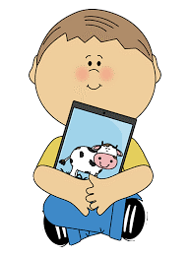
ICT
In Primary 5 the children develop their skills in the following areas:
Coding– unplugged and plugged
Publishing
Presenting
Managing Data
Film and Animation
Music and Sound
Art and Design
RE
We are using the Primary 5 Grow In Love Scheme which combines work on Scripture, Knowledge of the life of Jesus and the Church and Sacraments and Prayer. This also involves an element of spiritual development through home learning, especially in our current preparations for First Communion. We will
also be watching and participating with Mass online as part of our Communion preparation
and throughout the year.

Slide 14
PE
Due to Covid-19 restrictions, children will be required to wear their P.E gear into school. This consists of plain, unmarked navy-blue leggings/jogging bottoms and a plain white t shirt.
Our P.E day will be on a Monday at 2pm. The Daily Mile will take place each day.
Swimming: Swimming lessons at Downpatrick Leisure Centre will be starting in October. We will let you know which term our class are scheduled to go to swimming this year as soon as this is confirmed.

Slide 15
Homework
We will be using a combination of remote learning using the SeeSaw app and worksheets for homework.
The homework timetable is as follows:
Literacy and Numeracy worksheets will be used on Mondays and Tuesdays. Children will then bring these into school on the following day and marked together in class. These will be a mixture of Literacy and Maths activities.
On Wednesday and Thursday evenings Literacy, Numeracy and ICT activities will be posted on SeeSaw for the children to complete. I will then mark these online and return them digitally.
Homework will also consist of reading from the children’s Guided Reading sessions and phonics spellings to learn.
If for any reason your child is unable to complete their homework please send a note confirming this or contact me via SeeSaw.

Slide 16
Covid–19 Restrictions
The school will continue to follow all Education Authority's guidelines to ensure that our children are safe in school.
There are new drop off and pick up times, for Primary 5 this is 9.00am and 3.00pm in the afternoon. Children who have brothers and sisters in other classes can enter and leave school earlier.
Primary 5 will remain within our learning bubble throughout the day, in class and during break and lunch times, which are staggered.
The classroom is regularly sanitized, and children's hands washed throughout the day, at arrival in school, before and after break and lunch. Hand sanitizing lotion is available in class and as children enter the school. The children are welcome to bring their own sanitizing lotion with them.
School desks will be sanitized throughout the day.
Children can be dropped off at the school gate in the mornings. For your safety and the safety of others please keep 2m apart from other adults at the gate. If you have an appointment in the school please adhere to the social distancing measures in place within the school building.
PPE equipment is available for all staff to use as and when needed. Each classroom has a sanitizing station equipped with sanitizing materials.

Slide 17
Child Protection
We ensure that all our children will feel safe and secure at school. Please see our child protection brochure for parents which outlines the various procedures in place at St Brigid’s. If you have a concern, please do not hesitate in contacting the school.
The Safeguarding Team is as follows :
Designated Teacher for Child Protection ( DT) is Mrs A. Lloyd
Deputy Designated Teacher (DDT) is Mrs L. Devlin
Principal,(DDT) Mrs D. Miller
ICT Co Ordinator is Mrs C. Mc Cavera
Governor responsible for CP is Mrs P. Martin
Chairman of our Board of Governors, Mr B. Smyth.

Slide 18
Thank You.
I would to take this opportunity to thank for your patience and support. This has been a very challenging time for everyone and will continue to be a very unusual year for us all. if you have any concerns we will be here to help and support you. I look forward to working together with you through this.
Chris McCormick.

