Slide 1
Welcome to Primary Six
Information for Parents September 2020

Slide 2
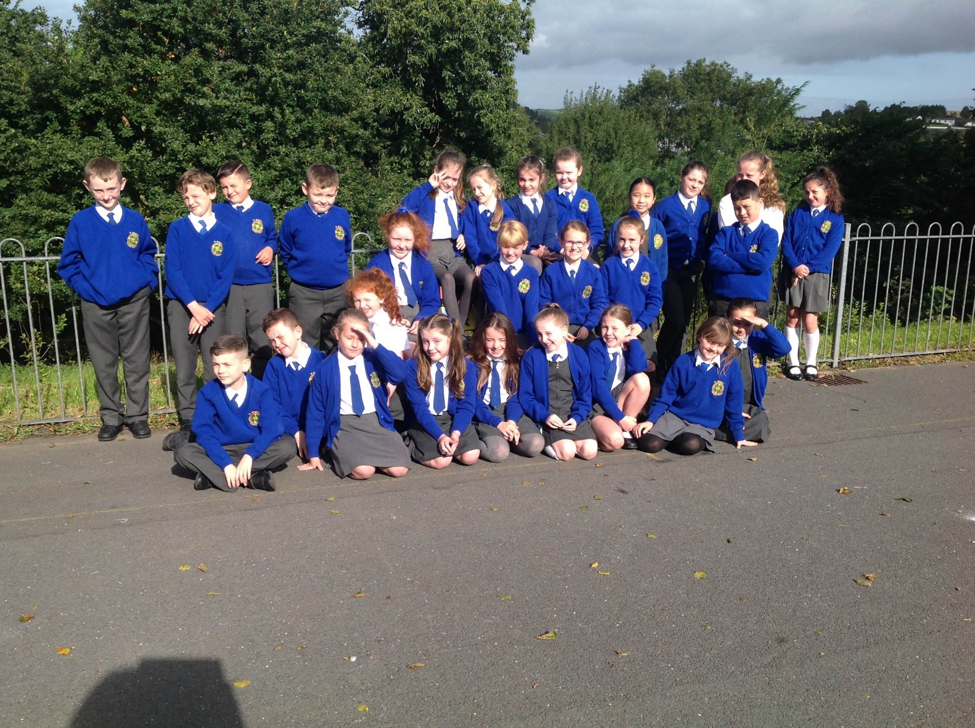

Slide 3
Welcome to all our Primary 6 families. It has been a very strange year for everyone. We are glad to see our children back to school and happy to be back at school as well.
This PowerPoint presentation will outline the plan for our next school year. Normally we would have curricular meetings which provides an opportunity to meet and chat about the year ahead. Unfortunately due to Covid- 19 we are unable to do that. However, if you wish to meet with me please do not hesitate to arrange a meeting.

Slide 4
The PowerPoint will outline the following areas of learning:
Literacy
Reading
Numeracy
World Around Us
PE
Transfer Procedure
Covid 19 Procedures
Homework
Child Protection
Housekeeping Issues
A.O.B

Slide 5
Literacy
Writing
There are many areas of writing that we cover throughout the year. Each term we will we also focus on one piece of writing per half term.
The writing areas area as follows :
Recount
Report
Instructional
Procedural
Narrative
Explanation
Persuasive
Discursive
Poetry
In Term 1 we will focus on Recount and Report writing.
In Terms 2 and 3 we will be exploring Narrative, Persuasive and Explanation writing.

Slide 6
Grammar and Punctuation, all areas of grammar and punctuation will be covered from simple capital letters, nouns to comparative and superlative adjectives. When reading with your child at home discuss aspects of grammar and how it can change the meaning of a story and also influence the way you read the story and the expression and tone of voice children may use.
Comprehension, pupils will be encouraged to use these 10 skills to help improve their understanding of their written text and to improve their reading and writing skills. These skills are as follows and something you can use with your child when reading with them at home:
Summarising
Clarifying
Synthesising
Visualising
Monitoring
Evaluating
Questioning
Predicting
Making connections
Inferencing
Each month we will focus on a particular skill, for Term 1 we will focus on summarising , questioning ,predicting and visualising .Term 2 will be clarifying, making connections ,evaluating and inferring. Term 3 will be synthesising and monitoring.

Slide 7
Phonics
Our phonics programme is designed to encourage children to explore the various ways that sounds can be represented i.e. Know, toe, boat.
We will begin with revision of last year's sounds, syllabification then we will move onto exploring sound families. Topic words will also be used.
Handwriting
We will continue to use the cursive style of writing.

Slide 8
Reading
Shared/Modelled
We will be reading our class novel which will be linked to our topic. This term we will be reading Under the Hawthorn Tree which links to the Famine topic we will be studying.
Guided Reading
Formal reading lessons will take place three times per week. Your child will be encouraged to take their reading book home each day as they will have reading practice at home. They will bring their book into school each day. Once the book has been completed then it will be quarantined.
Extra Reads
Your child will also be bringing a book home to read at their leisure to encourage independent reading. We will keep a record of these books. In Primary 6, children will be expected to complete their book in 10 days, some may choose a longer book. We would encourage you to read along with your child.
If any reading books are sent home and damaged, parents will be asked to make a financial contribution towards their replacement.

Slide 9
Tips to Help with your Child's Reading.
Take 15 minutes every evening to read to/ along with your child
Discuss what they are reading with them, ask them questions about the story, use the comprehension strategies we discussed earlier for example, can they summarise the story so far? Can they predict what they think will happen next?
If there are any difficult words, tell them the word.
If you feel that they should know the word, then bring them to the meaning of the story, use pictures if they are there. Look for any sounds that are familiar to them, use syllables as well.

Slide 10
Numeracy
The following areas of numeracy will be covered this year :
Processing
Number
Measures
Data Handling
Shape/ Space
Mental Maths strategies, children will practice and be encouraged to use the following mental maths strategies, counting on and back, using inverse operations, using factors, exploring equivalence, re-ordering numbers, partitioning of numbers and rounding and adjusting of numbers.
I would encourage you to explore these strategies at home with your child.

Slide 11
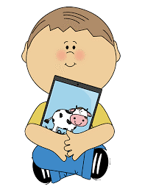
ICT
In Primary 6 the children develop their skills in the following areas:
Coding– unplugged and plugged
Publishing
Presenting
Managing Data
Film and Animation
Music and Sound
Art and Design
RE
We are using the Primary 6 Grow In Love Scheme which combines work on Scripture, Knowledge of the life of Jesus and the Church and Sacraments and Prayer. This also involves an element of spiritual development through home learning. We will also be watching and participating with Mass online.

Slide 12
World Around Us
The topics to be covered are listed below and we will be using a thematic approach and bringing in other areas of the curriculum i.e. science, geography, numeracy and literacy as well as other subjects into the topics :
Term 1 – Famine and Water
Terms 2/3 - Electricity , Titanic and a local study.
P.E
Due to Covid -19 restrictions, children will be required to wear their P.E gear into school. This consists of plain navy leggings/jogging bottoms and a white t shirt with the school logo.
Our P.E day will be on a Monday. The Daily Mile will take place each day.
Swimming, this is scheduled to begin in October. We will keep you informed

Slide 13
Transfer Procedure
Primary 6 will begin to use practice papers in March. Answer sheets will be provided to parents to mark these at home.
Summer Packs which will consist of a series of tests will be provided for completion by your child during the summer months and again answer sheets will be provided.
A Transfer Meeting will be held with the principal and the P.6 teacher(s) in June. At this meeting, all procedures and timetables will be discussed in detail.

Slide 14
Covid – 19 Restrictions
As you are aware the school will continue to follow the Education Authority's guidelines to ensure that our children are safe in school. Please remember the following:
The new drop off and pick up times, for P.6 this is 8.55am and 2.55pm in the afternoon. Children who have brothers and sisters in other classes can enter and leave school earlier.
P.6 will remain within its learning bubble throughout the day, during break and lunch times, which are staggered .
The classroom is regularly sanitised, and children's hands washed throughout the day, at arrival in school, before and after break and lunch. Their hands will be washed or sanitised before leaving school.
School desks will be sanitised throughout the day.
Children can be dropped off at the school gate in the mornings. For your safety and the safety of others please keep 2m apart from other adults at the gate and if you are in the school building. Please try not to stay too long at the gate.
PPE equipment is available for all staff to use as and when needed and each classroom is equipped with sanitising equipment.

Slide 15
Homework
We will be using a combination of remote learning to be put up online using Seesaw
and worksheets for homework.
The homework timetable is as follows:
Literacy and Numeracy worksheets will be distributed on Mondays. This will consist of activities to completed for both Monday and Tuesday. Children will then bring these into school on Wednesday to be marked in class.
On Wednesday, Literacy and Numeracy worksheets will once again be sent home to be completed for Friday. This will be returned on Friday to be marked in class.
Online homework through use of SeeSaw will posted on Wednesday. This will consist of two activities one in literacy and one in numeracy to be completed by Friday.

Slide 16
ICT
In Primary 6 the children develop their skills in the following areas:
Coding– unplugged and plugged
Publishing
Presenting
Managing Data
Film and Animation
Music and Sound
Art and Design
RE
We are using the Primary 6 Grow In Love Scheme which combines work on Scripture, Knowledge of the life of Jesus and the Church and Sacraments and Prayer. This also involves an element of spiritual development through home learning, especially in our current preparations for First Communion. We will also be watching and participating with Mass online as part of our Communion preparation and throughout the year.

Slide 17
Child Protection
We ensure that all our children will feel safe and secure at our school. Would you please see our child protection brochure for parents which outlines the various procedures in school. If you have a concern, please do not hesitate in contacting the school.
The Safeguarding Team is as follows :
Designated Teacher for Child Protection ( DT) is Mrs A. Lloyd
Deputy Designated Teacher (DDT) is Mrs L. Devlin
Principal, (DDT) Mrs D. Miller
ICT Co-ordinator , Mrs C. Mc Cavera
Governor responsible for CP is Mrs P. Martin
Chairman of our Board of Governors, Mr B. Smyth.

Slide 18
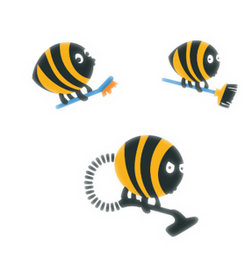
Housekeeping Issues
P.E will be every Monday.
The daily mile will be completed each day.
Swimming is scheduled to begin in October.
Healthy Eating, we are a healthy eating school, and we encourage children to bring a healthy snack each day.
School dinners resume for all children next week and the cost remains at £2.60.
Children will be asked to bring their guided reading books in every day. They cannot share them with anyone else, they have a copy each. Once the book is completed it will be quarantined for 72 hours.
Children will bring their books and homework into school in the homework folder provided.

Slide 19
Thank You.
I would to take this opportunity to thank for your patience and support. This will be a very unusual year for us all, if you have any concerns we will be here to help and support you. I look forward to working together with you through this.
A. Lloyd

