Slide 1

Welcome to Primary 4/5
A Guide for Parents

Slide 2

General Routines
From Monday 14th September, class starts for P4/5 at 9.00 and finishes 3.00 (Friday 2.00)
Children will enter the back door of the school and can be picked up from the yard using the side gates
If you have given written permission, children may walk to car park/home
Monies will all soon be paid electronically – but in the meantime, dinner money may be sent in an envelope, clearly marked which days your child is taking dinners.
Dinners remain at £2.60 per day
Breakfast club resumes from 14th September and costs 80p per day. Please let Mrs Moore know if you plan of avail of this
Please contact the office or advise me via seesaw/ email if your child is sick

Slide 3
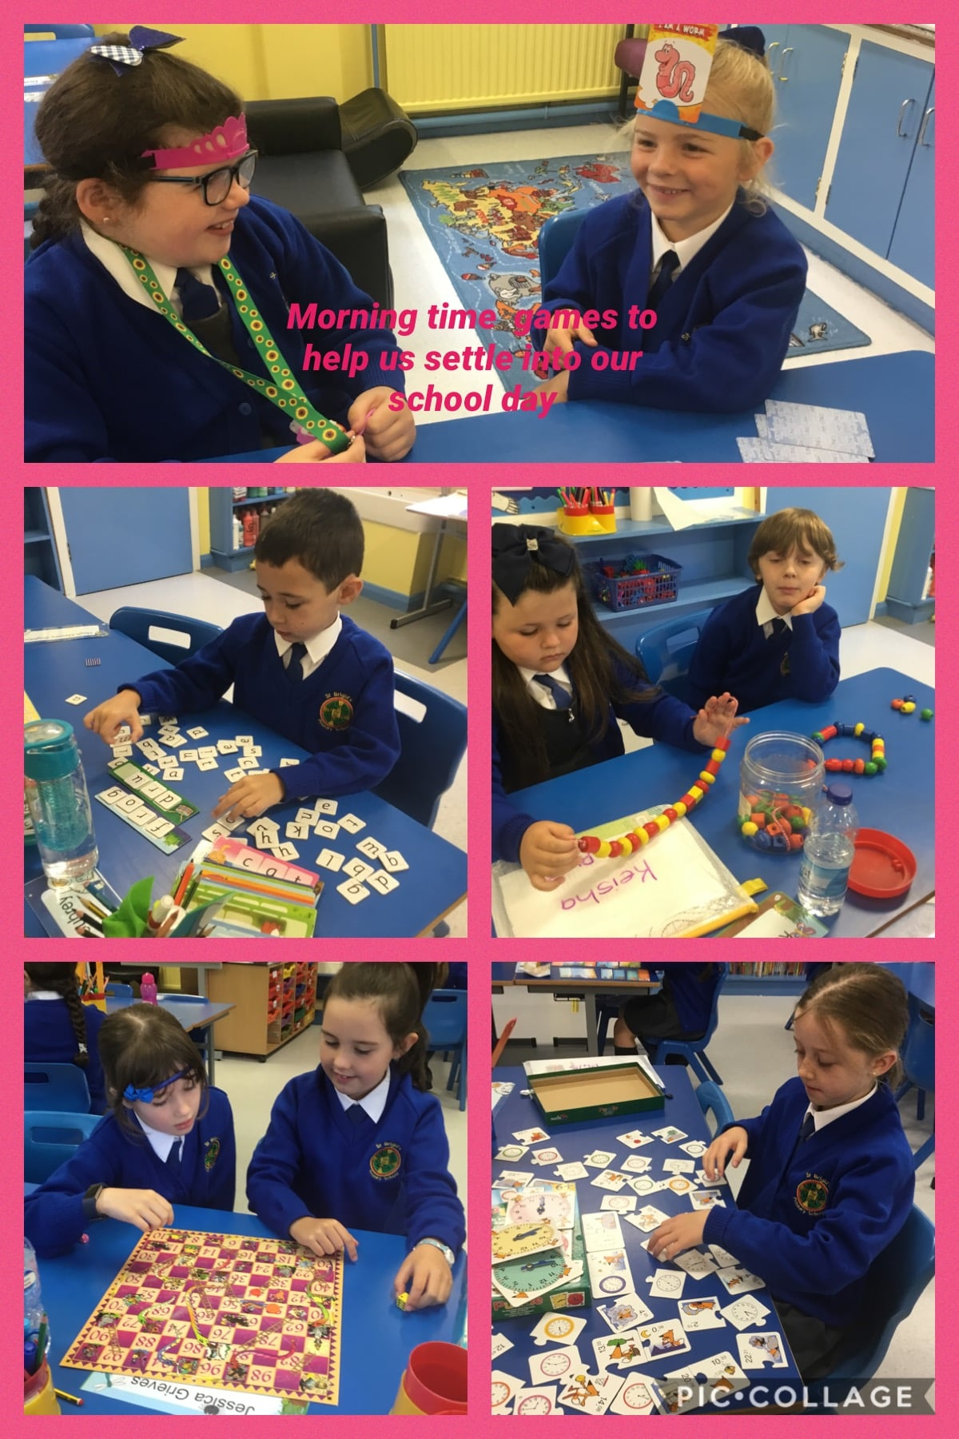

Slide 4

Literacy
Comprehension skills-summarising, questioning, clarifying and predicting.
Cursive Handwriting
Grammar and punctuation – alphabetical order, editing skills, nouns, pronouns, adverbs, adjectives, verbs, contractions, prefixes, suffixes, alliteration, metaphors, similes, tenses, synonyms, antonyms
Writing forms: recount, report, persuasive, procedural, poetry, explanation and narrative writing
Reading – Children will work through banded books. Reading homework will be given throughout the week as well as extra readers

Slide 5
Phonics
Phonics will be incorporated into our Literacy programme.
Tricky words should be practised every night (Your child should be able to read and spell all of these words in P4)
Help your child with their learning in preparation for their Friday assessment (dictation, quiz, puzzle)
Focus on sound rather than letter name
Structured phonics programme will be followed in class including using scaffolded texts, word building, see it right
Please encourage your child to sound out new words and “have a go” at the spelling

Slide 6

Curriculum
Numeracy
Number – place value; partitioning; addition, subtraction, multiplication and division; numberbonds; fractions; rounding numbers; counting totals of money and giving change
Shape: Properties of 2D and 3D shape, movement and direction
Data Handling: pie charts, decision trees, pictograms and probability
Measures: length, weight, time, area, volume and capacity
Mental Maths
At home you can help your child by :
-developing a quick recall of number bonds and multiplication and division facts, doubling and halving numbers
-Practice word problems to develop confidence in this area
-Encourage your child to independently tell the time, count money, measure out ingredients etc.
-Revise times tables every night

Slide 7
WAU Curriculum
World Around Us
Geography History Science
Wonderful Me: The human body
The Rainforest
St. Patrick and Ireland
Fairtrade
Space

Slide 8
Religion - Sacraments
P5 will receive the sacrament of Holy Communion on 19th September
P4 will receive the Sacrament of Reconciliation on 22nd October at 11am
P4 will receive the sacrament of Holy Communion on 15th May 2021
Children will follow the Grow in Love programme
Children will watch mass online in school

Slide 9
PE
Dance
Games
Athletics
Gymnastics
Ensure your child has plain navy joggers/leggings, PE t-shirt, trainers and school cardigan/jumper which they will wear to school every Wednesday.
We hope to introduce a school quarter zip as soon as possible which can be worn on PE day.
PE is every Wednesday 2.00 – 3.00
Children will also participate in the daily mile, ensuring they get regular daily exercise and work breaks.

Slide 10
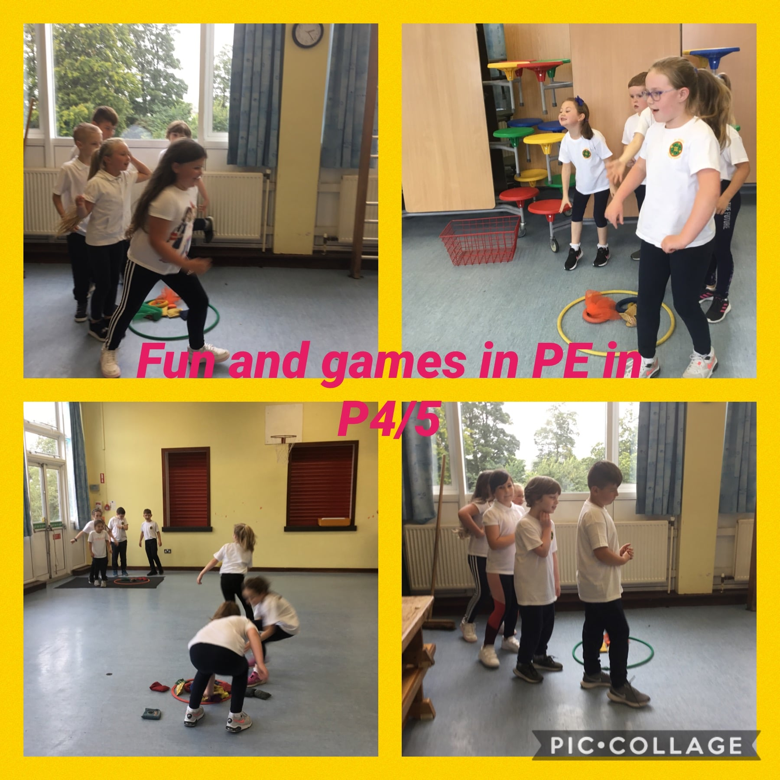

Slide 11
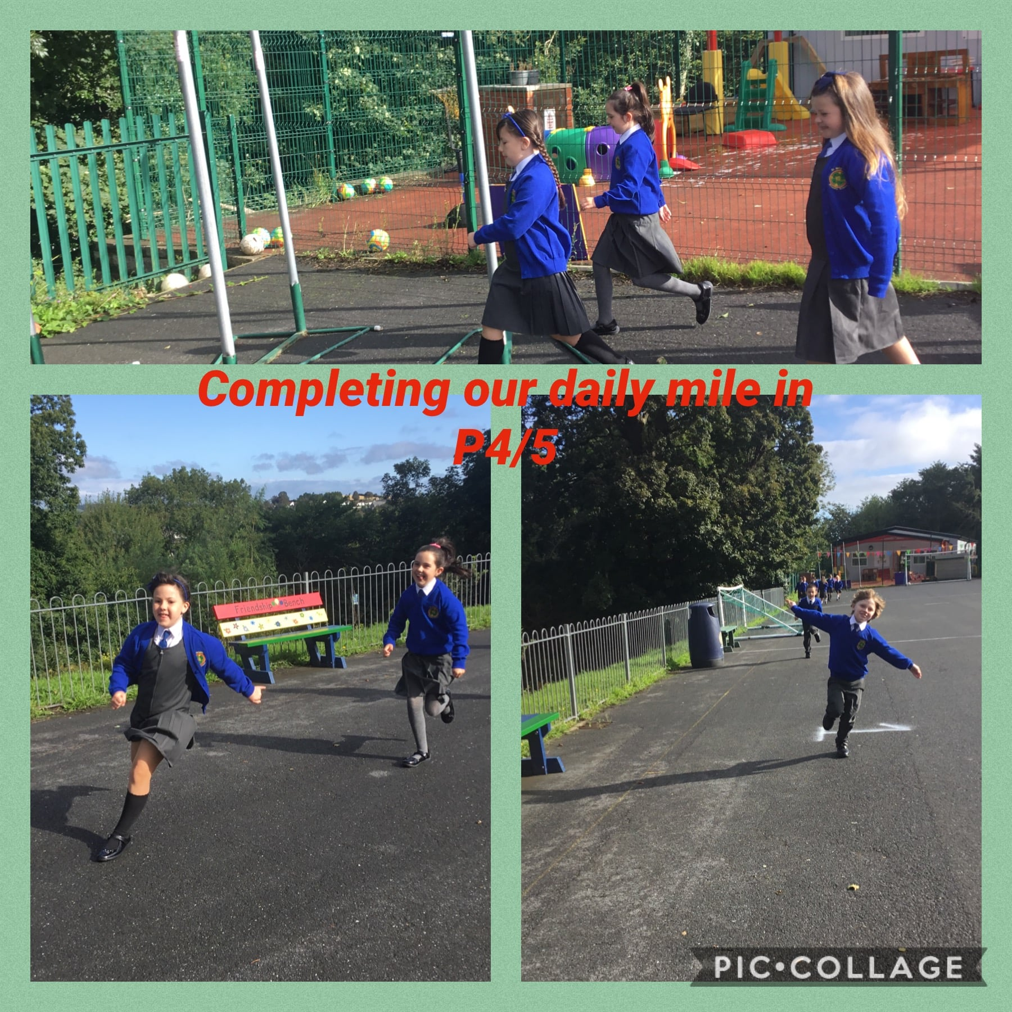

Slide 12
Nurture Group/PDMU
The children are really enjoying our new class nurture group.
We discuss our feelings and emotions.
We explore how we could deal with difficult situations.
We enjoy a range of fun activities as well as some relaxation and mindfulness.
We finish with a little snack.

Slide 13
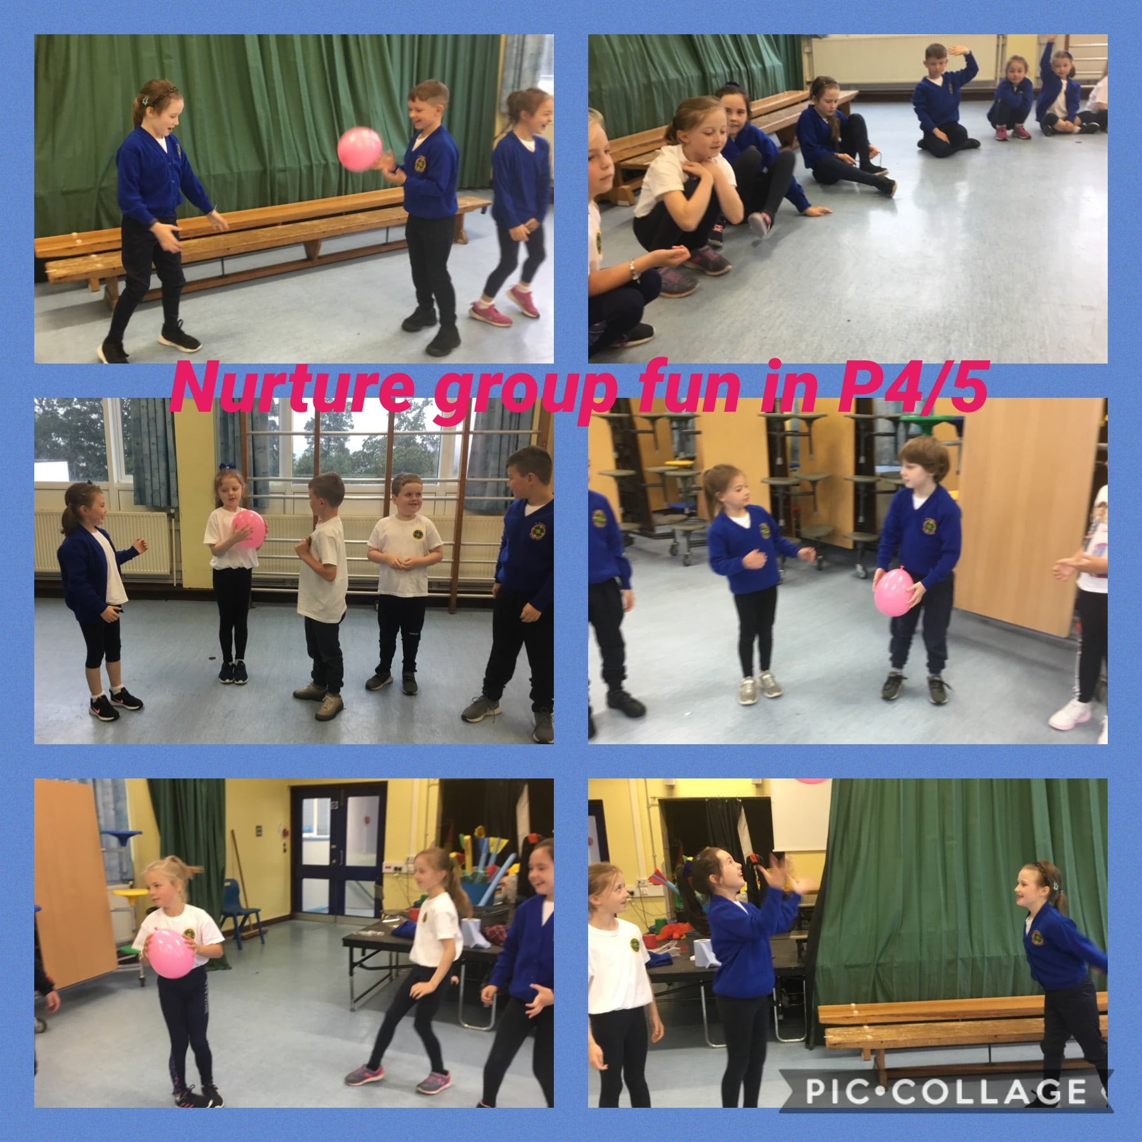

Slide 14
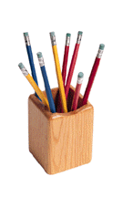
Homework
Homework will be given mental maths and metal English homework every night and should be returned to school the following day. Children will mark this in class he following day. If there is something that your child does not understand, please mark this so that I can help them the following day.
Tasks and activities will also be set via the seesaw app. Children should ensure these are completed every week.
Reading and extra readers will be sent home throughout the week. The school reading book takes priority over any extra readers and should be returned and signed by the following day. I will clearly mark these with a star in your child’s reading record book.
Pupils will be provided with extra reading books and they should revise their weekly phonics and times tables every night.
Homework should be of a good standard in content and presentation
All homework and reading should be signed.

Slide 15
Class Behaviour Code
Work quietly.
Listen to the teacher.
Always do your best work.
Keep my desk area tidy.
Keep my cloakroom area tidy.
Do not run in school.
Always put your hand up to ask a question.
Follow our class and school rules
Enjoy school and have fun. Treat others nicely.

Slide 16
How can I help my child?
Read with your child every night; either to them or hear them read.
Go over spellings/tables/numberbonds.
Insist on your child’s best work when completing homework.
If you have any concerns or wish to contact me, you can contact me via seesaw or email: ldevlin925@c2kni.net
Your child should only be bringing a coat, lunch box and their plastic folder to and from school each day

Slide 17
Other Information
ICT: login for my school will be sent home (encourage your child to use this at home. They can save any work completed at home which they can then access in school). They can also access Newsdesk
Class Nurture Sessions have started were your child is encouraged to express their feelings and engage in circle time. They enjoy fun activities within a comfortable environment
Healthy Break Time – please avoid sweets, chocolate
Keep up to date with work and notes on seesaw app
Check out our school website www.stbrigidsprimaryschool.com

Slide 18
Child Protection
Your child’s health and safety and wellbeing is our paramount concern.
Ms Lloyd is the designated teacher for child protection
Mrs Miller and Mrs Devlin are the deputy designated teachers for child protection.
If you have any concerns about your child’s health and wellbeing, please speak to us about this.

Slide 19
Aims for your child
To be happy and safe.
To enjoy P4/5.
To work to their highest potential.
To be proud of their work.
To be responsible for their own actions.
To become an independent worker.

Slide 20
My job is to provide love, care and support to your child whilst helping them learn. I will do my utmost to support them this year in their development and progress, whilst creating a safe and fun classroom environment.
I look forward to the coming year and to working with you as parents to help your child achieve the best that they can.
If there are any issues that may arise throughout the year, please do not hesitate to contact me.
Many Thanks
Mrs Devlin

