Slide 1
PRIMARY 7
2020-21

Slide 2
General Housekeeping
School starts at 8.45am and ends at 2.45pm for the P.7 class. We finish at 1.55 pm on a Friday
P.7 pupils enter through the side door at Plantation Park and leave by the back double doors.
Dinners are still £2.60 per day. (Please pay online or have correct payment in an envelope)
P.E. – this will take place each week( Tuesday 1.40pm – 2.40pm) – Children are required to wear white t-shirt, navy tracksuit / leggings and training shoes no uniform required that day.
Healthy eating – children are encouraged to bring a healthy snack for both break and lunchtime. Still water is permitted to be brought into class.
Full Attendance and punctuality is important in the effective running of the school however we can’t take any chance at this time coming to school when feeling unwell.
Swimming – No word at this time, will keep you posted when there is a change.

Slide 3
Literacy
Reading – formal reading lessons will take place twice weekly. Your child is encouraged to read at home and you are encouraged to read along with your child
Writing – we will be focussing on a variety of writing styles this year . With our first writing focus being Recount.
Comprehension – we will continue to expand on the skills acquired and encourage the children to read the passages with parents before tackling the questions at home.
Phonics – we will be continuing with the phonics programme. Spellings will be given out on a Monday and assessments will be carried out on a Friday.
Hand writing – we will continue to develop the cursive style of handwriting.
Talking and Listening - exercises will be on a variety of curriculum and topical issues and the pupils will be encourage to participate fully.

Slide 4
Numeracy
Numeracy – Areas to be covered this year are listed below.
Processing
Number
Measures
Data Handling
Shape and Space
Mental maths and Investigations
AREAS OF FOCUS - MEASURES ( Term 1 Length )

Slide 5
WAU
Topics to be covered this year are –
Flight ( Term 1)
Our World
Faith and Light
Young Enterprise
The Olympics

Slide 6
COMMUNICATION
We will use the Seesaw pupil App for setting work for the pupils .
The Seesaw Family App will be used for private communications with class teacher.
Please put a note on homework if you need to draw the teachers attention to difficult aspects of homework.
Please make an appointment through the office if you need to speak with the class teacher.

Slide 7
COVID RESTRICTIONS
As you are aware the school will continue to follow the Education Authority's guidelines
to ensure that our children are safe in school. Please remember the following:
P.7 will remain within its learning bubble throughout the day, during break and lunch times, which are staggered .
The classroom is regularly sanitised, and children's hands washed throughout the day, at arrival in school, before and after break and lunch. Their hands will be washed or sanitised before leaving school.
School desks will be sanitised throughout the day.
Children can be dropped off at the school gate in the mornings. For your safety and the safety of others please keep 2m apart from other adults at the gate and if you are in the school building. Please try not to stay too long at the gate.
PPE equipment is available for all staff to use as and when needed and each classroom is equipped with sanitising equipment.

Slide 8
Aims for this year in P.7
To be happy and safe.
To work to our highest potential.
To be proud of our work.
To be responsible for our own actions.
To become an independent worker.
To enjoy P7.

Slide 9
LET’S INSPIRE OUR CHILDREN TO BE THE BEST THEY CAN BE.
Give a little more than you have to.
Try a little harder than you want to.
Aim a little higher than you think possible.
Art Linkletter

Slide 10
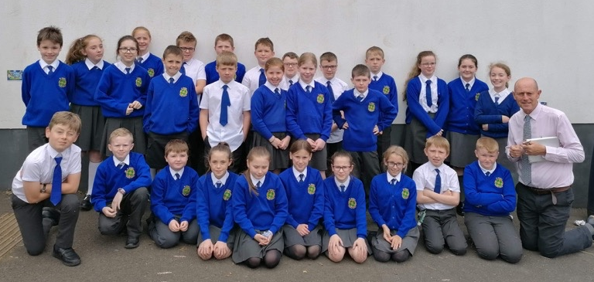
Primary 7

