Slide 1
The Great Irish Famine
Meabh and Donncha

Slide 2
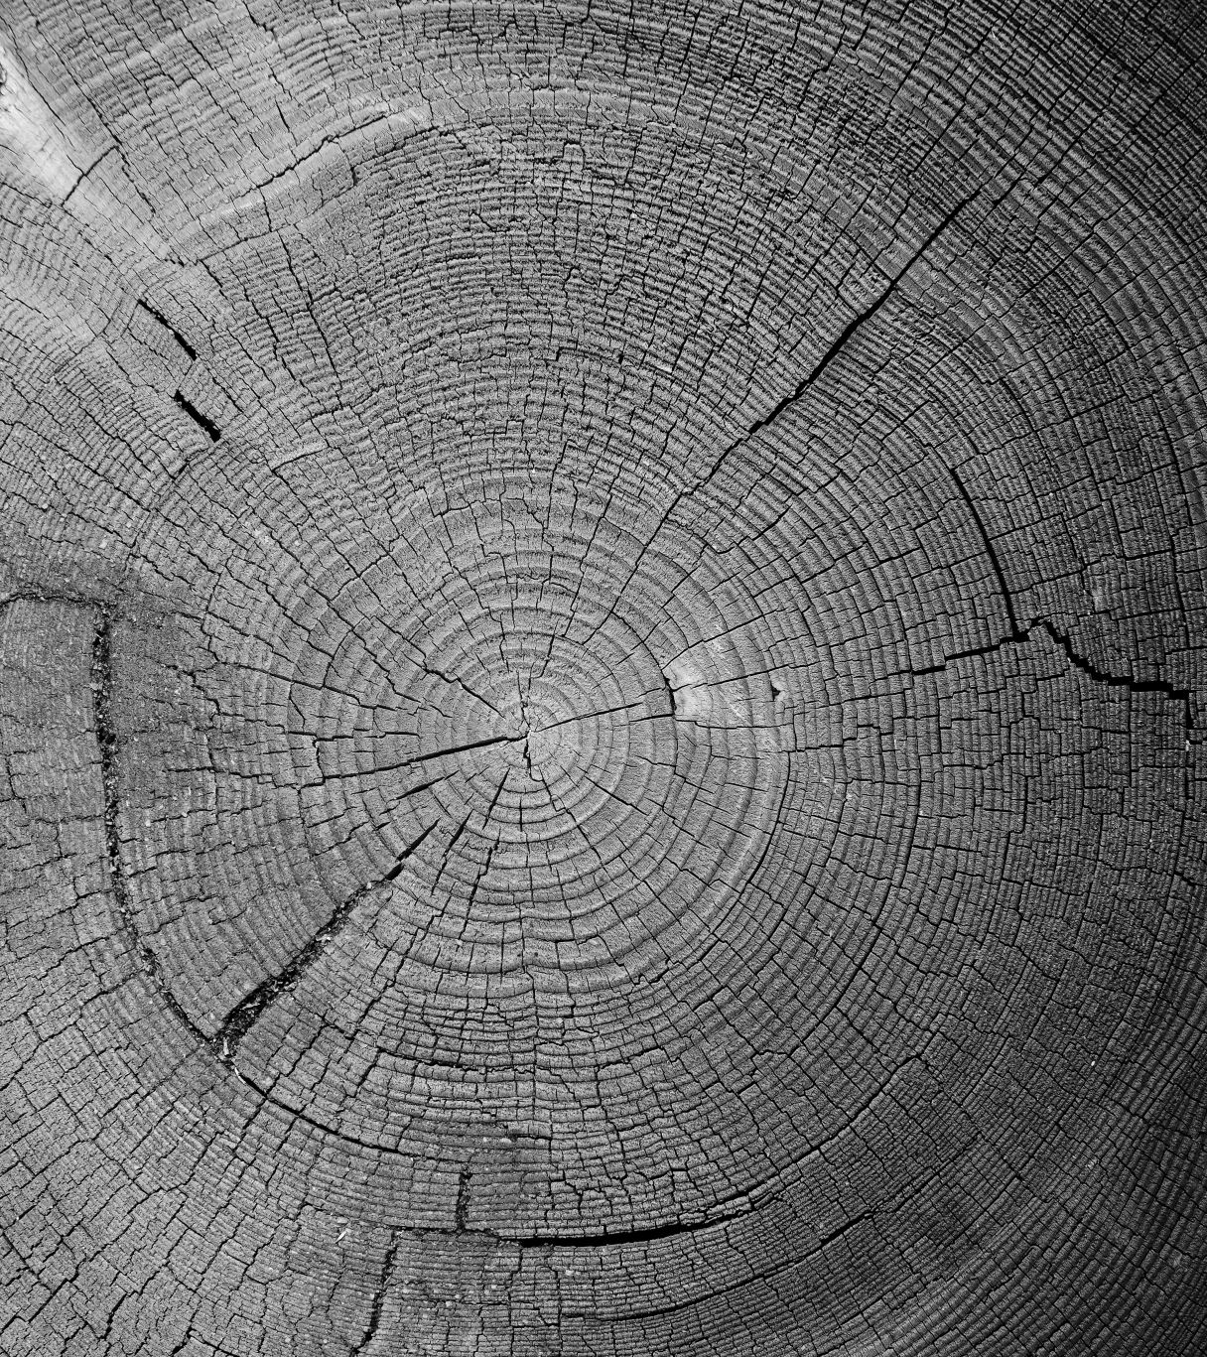
What was the Famine?
The Famine was a disease that was spread over Ireland and other countries.
The famine began in the 1800s

Slide 3
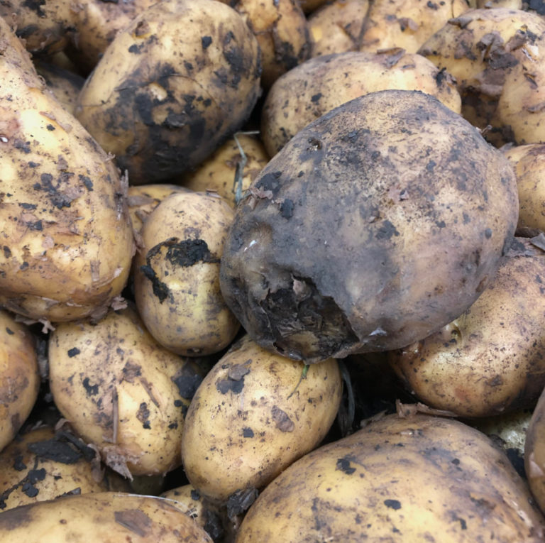
The Blight
The Blight was a disease that made all the potatoes rot, in the 1800s.
This disease spread all over Ireland, it mostly effected the west.
Millions died, many emigrated and others went to the workhouses.

Slide 4
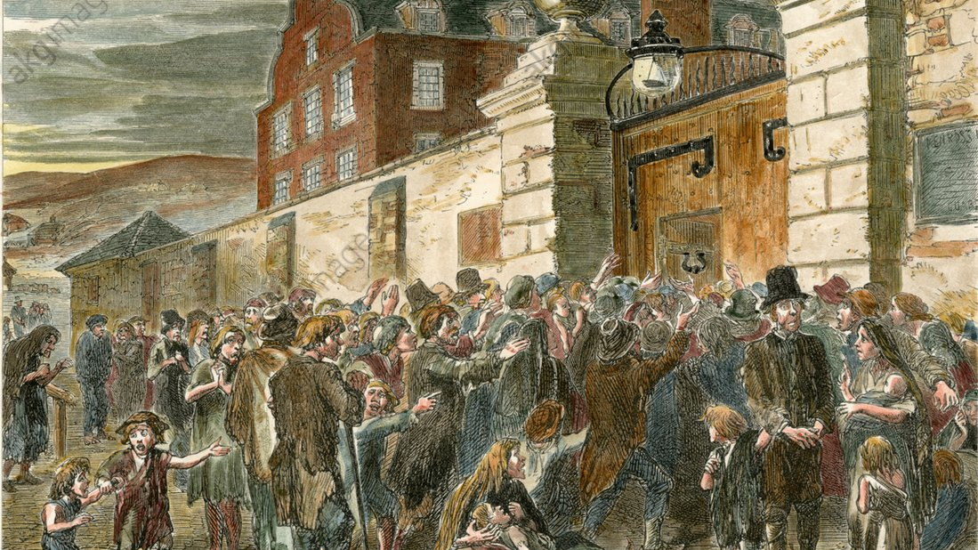
The Workhouses
The Workhouses were places for peasants who had nowhere to go, therefore they had no choice
People would stand outside the workhouse until somebody inside died.
It was a living torture, because if you went in there was no chance of getting out.
They ate oatmeal and bread and drank sweet milk and buttermilk.

Slide 5
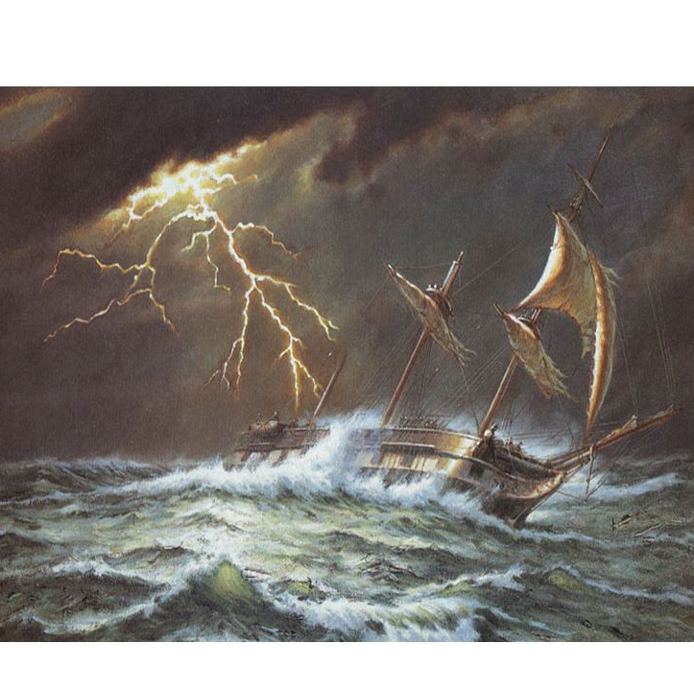
Coffin ships
1 in 6 people travelling on a coffin ship died, but it was the only option for many.
When people went on a coffin ships they mostly emigrated to North America.

Slide 6
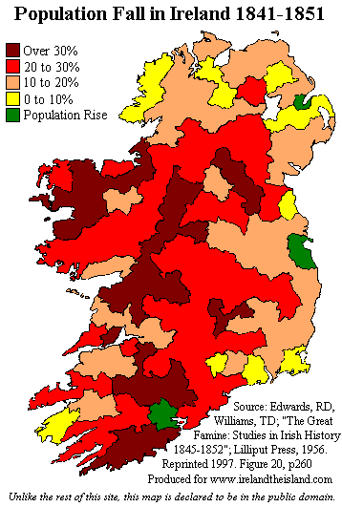
The Effects of the Famine
The Famine caused Irelands population to decrease by over 1 million.
The Irish population were to overdependent on the potato crop which killed most of the potato lovers.

