Slide 1
The Great Irish Famine
By Emily and Olivia

Slide 2
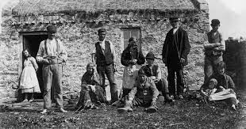
What was the Famine ?
In 1845- 1852 Ireland suffered a long period of starvation, disease and which is now known as The Great Irish Famine.
Crops had failed before but while The Famine was happening it failed across the country.

Slide 3
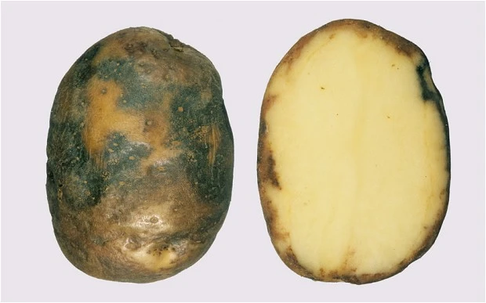
The blight
Potatoes were poisoned by a disease called potato blight a fungus that attacks the crop making them rot and become black.
As a direct consequence of The Famine near l million died and around 2 million people emigrated from the country.

Slide 4
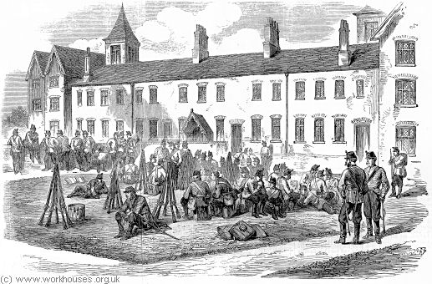
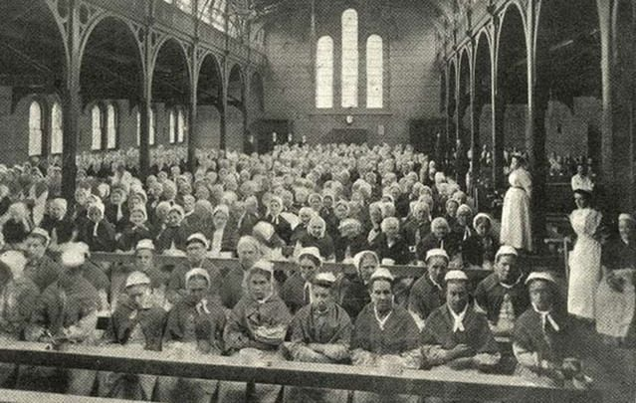
Workhouses
Life in the workhouses was horrible with no proper care and disgusting clothing supplies.
Many died in the workhouses because it wasn’t clean and was a disgusting place to be in. When you came in, you weren’t coming out.

Slide 5
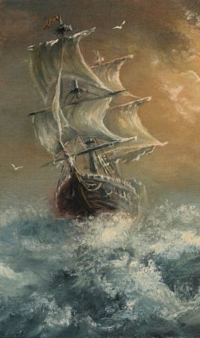
The Coffin Ships
When people were on Coffin Ships 1 out of 6 people were most likely to die.
Coffin Ships were used for taking people out of the country.
Most people emigrated to North America.

Slide 6
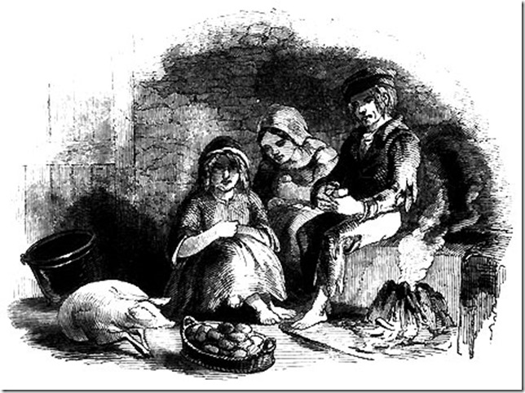
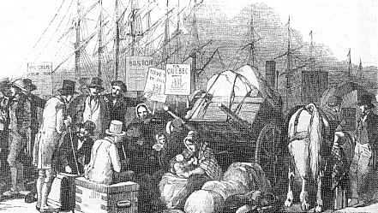
The effects of the Famine
Workhouses were full with people looking for aid and relief
Approximately half a million tenants were evicted by their landlords
Over one million people died for starvation or disease
One and a half million Irish people emigrated between 1845 and 1851
Large farms were subdivided into smaller farms.
Public work schemes were set up for people to earn money by building walls, roads or bridges

