Slide 1
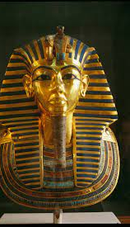
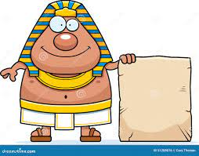
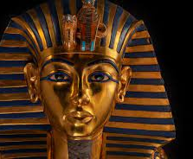
The Ancient Egyptians
By Louis Magee P6

Slide 2
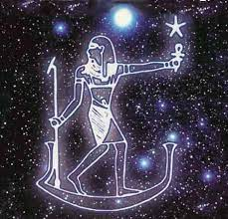
Contents page
Slide 1-where is Egypt?
Slide 2-hieroglyphics
Slide 3-gods and goddesses
Slide 4-pyramids
Slide 5-pharaohs

Slide 3
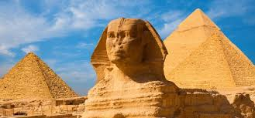
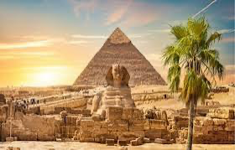
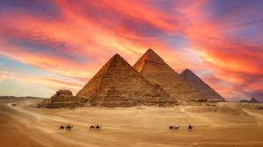
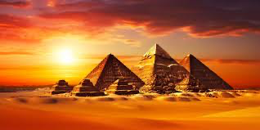
Where is Egypt?
Egypt is a country far from Ireland it's also an enormous country where people use to preserve human body so that it won't rot. They also took out the origins of their body and put them in special jars called canopic jars the jars have heads of different animals and some of the heads are bigger than others.

Slide 4
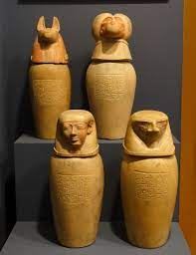
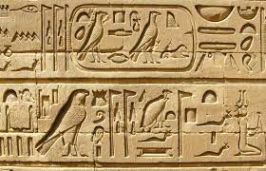
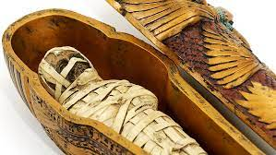
Hieroglyphics
Egyptians were odd people who wrote in different writing than most people they used hieroglyphics which was a very strange way of writing to us because most of the letters were pictures like L is a lion and U is a baby bird and A is an eagle it's very different to our writing now like very different to us it's very unique and unusual.

Slide 5
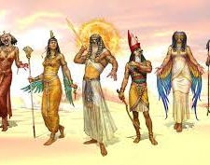
Gods and goddesses
Gods and goddesses are Egyptian gods probably the most famous one is Ra he was the god of the sun for the Egyptians the believe that he was a little egg in the ocean and when hatched he got bored and flew up into the sky with his wings and he became the sun. The earth god was a goddess her name was nut she could control the earth with her hands and she was probably very strong.

Slide 6
Pyramids
The pyramids were massive limestone building that had around 5.5 million tonnes of limestone at that time it took probably about 200 years to build because at that time there was no cranes or stuff like it they had to use their bare hand and nobody knows how they got it to be so tall so it's a mystery.

Slide 7
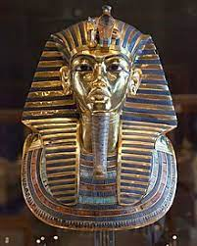
Pharaohs
Pharaohs are one of most common that comes to your mind when you think about Egypt and there is a very famous pharaoh called Tutankhamun his tomb was found in 1922 by an explorer team and there is way more pharaohs but that is the most famous one in my opinion maybe you know an even more famous one so tell me.

